Slide 1

小清新＋轻质感工作汇报模板
THESIS DEFENSE POWERPOINT TEMPLATE
戚耀磊

Slide 2
2021年度研究关键词
The word frequency in 2021 strudy
生成网络
损失函数设计
肾动脉分割
自然图像迁移
先验知识融合
眼底血管分割
血管分割
迁移学习
医学图像迁移
冠状动脉分割
领域知识嵌入
中心线提取
解剖先验知识
血管跟踪
先验知识提取
位置先验知识
狭窄检测
特征先验知识
钙化斑块检测
注意力机制
多器官分割
构图
结构间先验知识
图像后处理
图卷积

Slide 3
会议—通过学习图形的连接性实现深度血管分割
Deep Vessel Segmentation By Learning Graphical Connectivity
Main idea: 主观点
Existing methods using CNNs have mostly relied on local appearances learned on the regular image grid, without considering the graphical structure of vessel shape.
现有的使用cnn的方法大多依赖于在规则图像网格上学习到的局部外观，没有考虑血管形状的图形结构。
Critical method: 关键方法
We incorporate a graph convolutional network into a unified CNN architecture, where the final segmentation is inferred by combining the different types of features.
我们将一个图卷积网络融合到一个统一的CNN架构中，通过结合不同类型的特征来推断最终的分割
Shin S Y , Lee S , Yun I D , et al. Deep Vessel Segmentation By Learning Graphical Connectivity[J]. 2018.

Slide 4
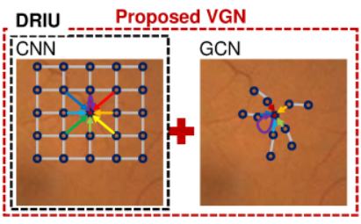
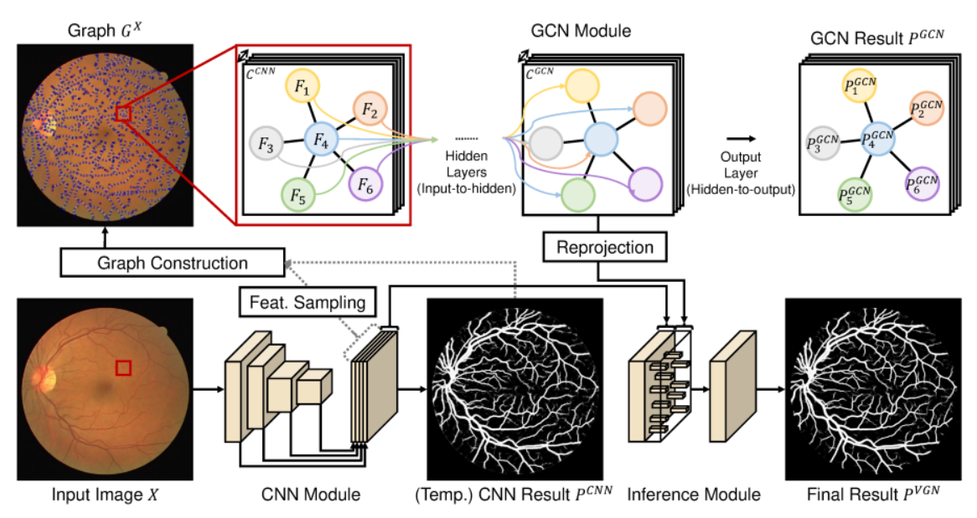
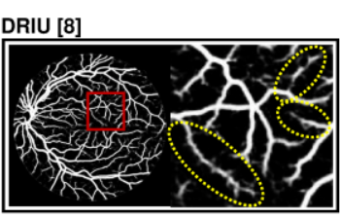
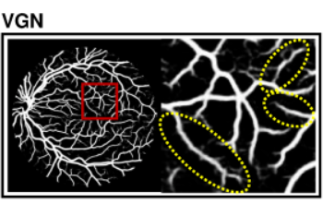
会议—通过学习图形的连接性实现深度血管分割
Deep Vessel Segmentation By Learning Graphical Connectivity
预训练好CNN，提供阈值，骨架，顶点以及生成边
Shin S Y , Lee S , Yun I D , et al. Deep Vessel Segmentation By Learning Graphical Connectivity[J]. 2018.

Slide 5
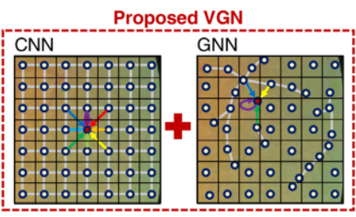
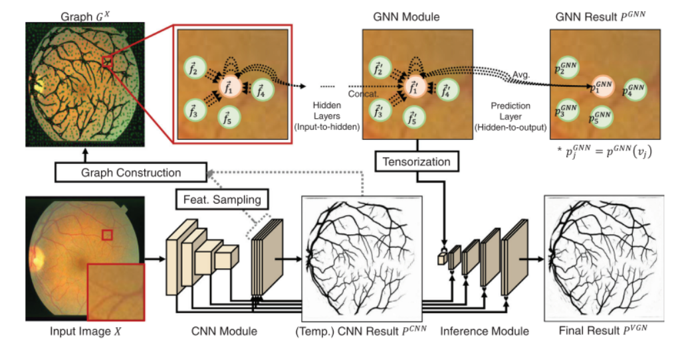
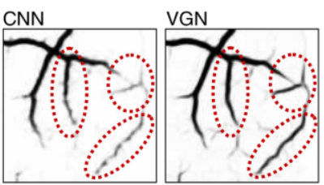
期刊—通过学习图形的连接性实现深度血管分割
Deep vessel segmentation by learning graphical connectivity
Shin S Y , Lee S , Yun I D , et al. Deep Vessel Segmentation By Learning Graphical Connectivity[J]. 2018.

Slide 6
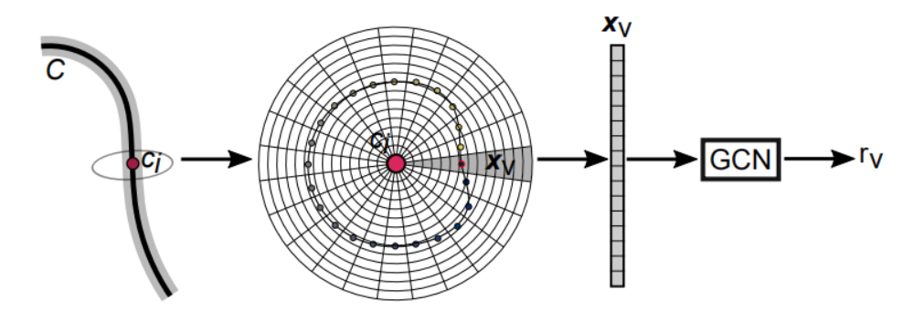
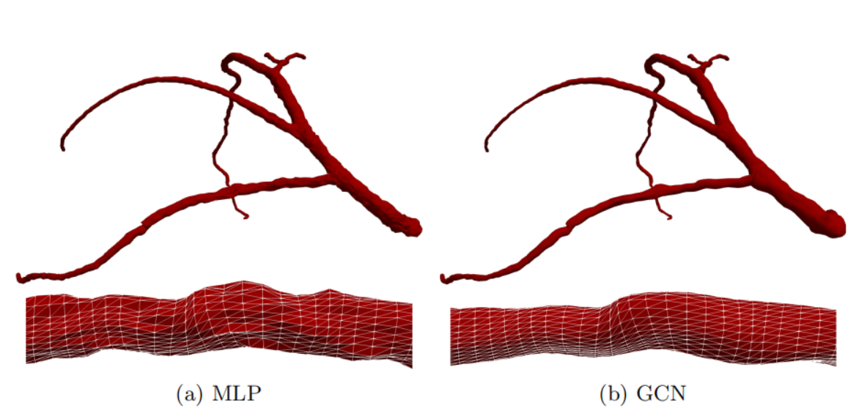
会议—图卷积网络实现CCTA图像的冠状动脉分割
Graph Convolutional Networks for Coronary Artery Segmentation in Cardiac CT Angiography
Main idea: 主观点
Detection of coronary artery stenosis in coronary CT angiography (CCTA) requires highly personalized surface meshes enclosing the coronary lumen. In this work, we propose to use graph convolutional networks (GCNs) to predict the spatial location of vertices in a tubular surface mesh that segments the coronary artery lumen.
冠状动脉CT血管造影(CCTA)中冠状动脉狭窄的检测需要高度个性化的表面网格包围冠状动脉管腔。在本工作中，我们提出使用图卷积网络(GCNS)来预测管状表面网格中的顶点的空间位置，该网格分割冠状动脉管腔。
Wolterink J M , Leiner T , Igum I . Graph Convolutional Networks for Coronary Artery Segmentation in Cardiac CT Angiography[M]. Springer, Cham, 2019.

Slide 7
会议—用于高维数据理解的注意力驱使的树状结构卷积LSTM
Attention-driven Tree-structured Convolutional LSTM for High Dimensional Data Understanding
Main idea: 主观点
The hierarchical data structures in a significant amount of tasks (e.g., human body parts and vessel/airway tree in biomedical images) cannot be properly modeled by sequential models.
大量任务中的分层数据结构（例如生物医学图像中的人体部件和血管/气道树）不能用顺序模型正确建模。
Critical method: 关键方法
We present tree-structured ConvLSTM models for tree-structured image analysis tasks which can be trained end-to-end. To demonstrate the effectiveness of the proposed tree-structured ConvLSTM model, we present a tree-structured segmentation framework which consists of a tree-structured ConvLSTM and an attention fully convolutional network (FCN) model.
我们提出了树结构ConvLSTM模型，用于树结构图像分析任务，这些任务可以端到端进行训练。为了证明所提出的树结构ConvLSTM模型的有效性，我们提出了一个树结构分割框架，该框架由树结构ConvLSTM和注意力完全卷积网络(FCN)模型组成。
Bin Kong, Xin Wang, Junjie Bai , et al. Attention-driven Tree-structured Convolutional LSTM for High Dimensional Data Understanding[J]. 2019.

Slide 8
期刊—学习树结构表征实现3D冠脉管腔分割
Learning tree-structured representation for 3D coronary artery segmentation
Motivation: 动机
Inspired by recent ideas to use tree-structured long short-term memory (LSTM) to model the underlying tree structures for NLP tasks, we propose a novel tree-structured convolutional gated recurrent unit (ConvGRU) model to learn the anatomical structure of the coronary artery.
受最近使用树结构长期短期记忆(LSTM)来建模NLP任务的底层树结构的启发，我们提出了一种新的树结构卷积门控复发单元(ConvGRU)模型来学习冠状动脉的解剖结构。
Critical method: 关键方法
To conduct voxel-wise segmentation, a tree-structured segmentation framework is presented. It consists of a fully convolutional network (FCN) for multi-scale discriminative feature extraction and the final prediction, and a tree-structured ConvGRU layer for anatomical structure modeling.
为了进行体素方面的分割，提出了一个树状结构的分割框架。它包括一个用于多尺度鉴别特征提取和最终预测的全卷积网络，以及一个用于解剖结构建模的树状结构ConvGRU层。
Kong B , Wang X , Bai J , et al. Learning Tree-Structured Representation for 3D Coronary Artery Segmentation[J]. Computerized Medical Imaging and Graphics, 2019, 80:101688.

Slide 9
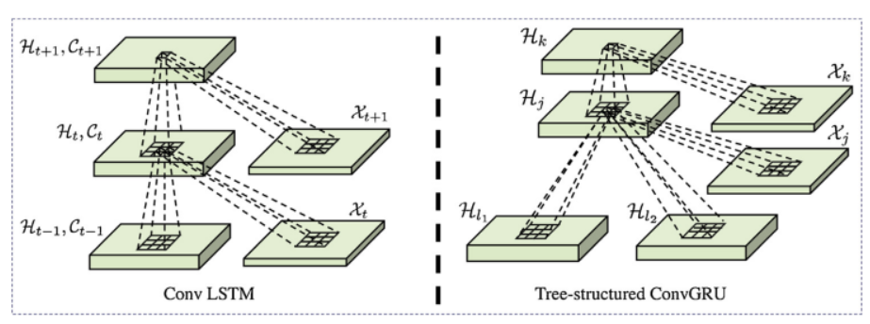
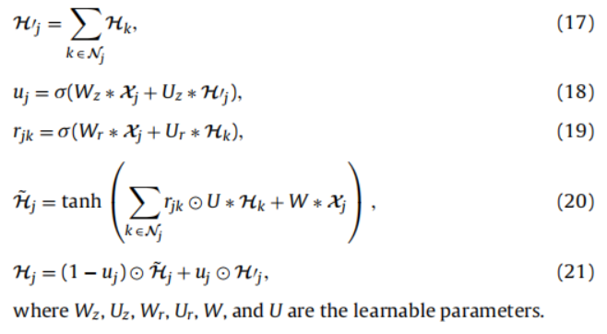
期刊—学习树结构表征实现3D冠脉管腔分割
Method: 方法
We propose a novel tree-structured
ConvRNN network for extracting tree-structured anatomical information, in which the parent node selectively aggregates features from all its child nodes.
我们提出了一种新的树结构ConvRNN网络来提取树结构的解剖信息，其中父节点选择性地从其所有子节点聚合特征。
Learning tree-structured representation for 3D coronary artery segmentation
Method: 方法ConvRNN
Vessels with tubular structures and bifurcations gradually change geometry and elongation from proximal to the distal end. We aim to utilize RNN models to extract anatomy related features.
血管的管状结构和分叉从近端到远端会逐渐改变几何形状和伸长。我们的目标是利用RNN模型提取解剖学相关特征。
H_{t-1}表示先前的隐藏层
C_{t-1}表示先前的存储
X_{t}表示当前的输入
H_{l1}和H_{l2}表示来自其两个子节点的隐藏层
X_{j}表示当前的输入
Kong B , Wang X , Bai J , et al. Learning Tree-Structured Representation for 3D Coronary Artery Segmentation[J]. Computerized Medical Imaging and Graphics, 2019, 80:101688.

Slide 10
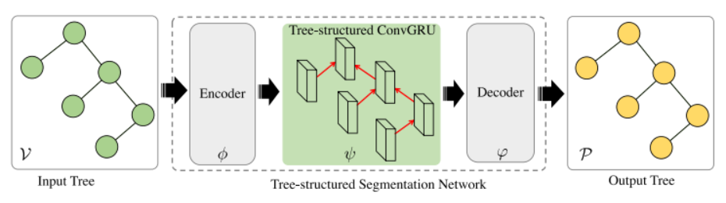
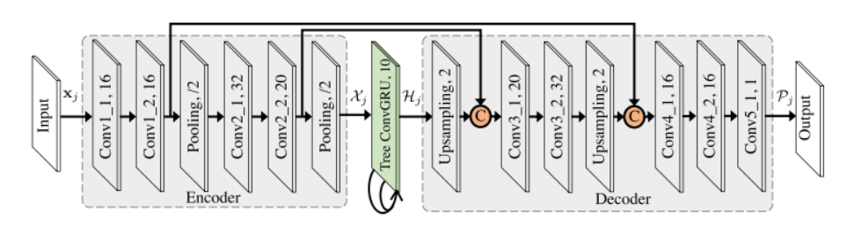
期刊—学习树结构表征实现3D冠脉管腔分割
Pipeline: 流程
1. 中心线提取 (最小路径算法)
2. 沿着中心线垂直方向的CCTA图上裁剪横截面视角
3. 用动脉强度以及钙化板块阈值标准化——区分斑块和血管
4. 将标准化的patch与原始的patch连接起来
5. 从而得到一个Tree-channel的图像以及对应个节点
6. 目标就是要学习一个非线性函数，将树结构输入映射到树结构输出。
Learning tree-structured representation for 3D coronary artery segmentation
Kong B , Wang X , Bai J , et al. Learning Tree-Structured Representation for 3D Coronary Artery Segmentation[J]. Computerized Medical Imaging and Graphics, 2019, 80:101688.

Slide 11
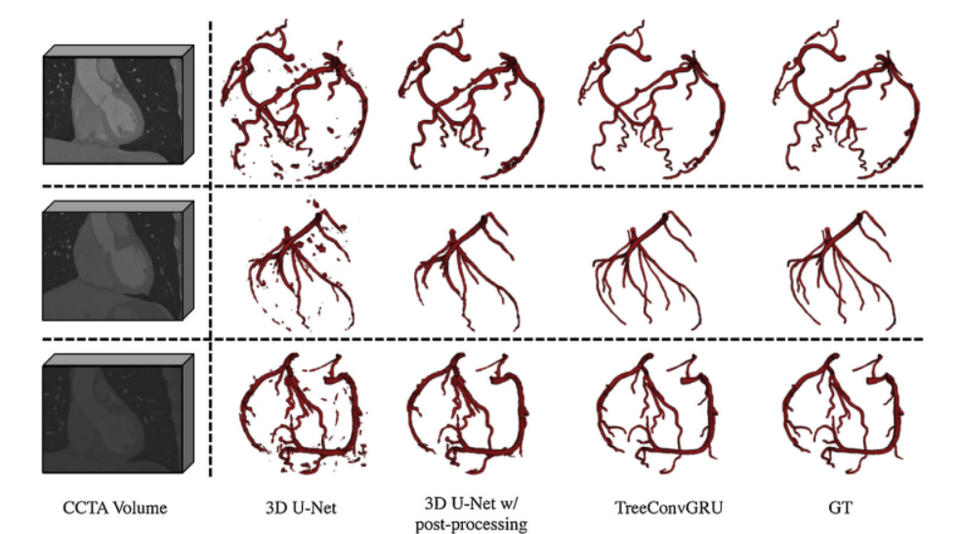
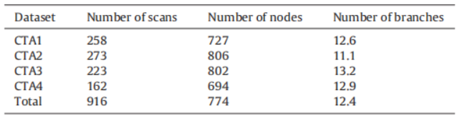
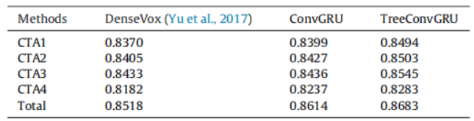
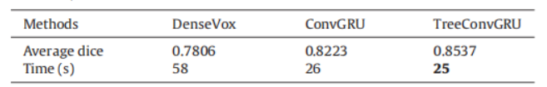
期刊—学习树结构表征实现3D冠脉管腔分割
Learning tree-structured representation for 3D coronary artery segmentation
Kong B , Wang X , Bai J , et al. Learning Tree-Structured Representation for 3D Coronary Artery Segmentation[J]. Computerized Medical Imaging and Graphics, 2019, 80:101688.

Slide 12
期刊—通过跟踪多个统计排序假设提取CT图像的树状结构
Extracting Tree-structures in CT data by Tracking Multiple Statistically Ranked Hypotheses
Main idea: 主观点
In this work, we adapt a method based on multiple hypothesis tracking (MHT) that has been shown to give state-of-the-art vessel segmentation results in interactive settings, for the purpose of extracting trees.
在本工作中，我们采用了一种基于多假设跟踪(MHT)的方法，该方法已被证明在交互设置中给出了最先进的血管分割结果，用于提取树。
Critical method: 关键方法
Regularly spaced tubular templates are fit to image data forming local hypotheses. These local hypotheses are then used to construct the MHT tree, which is then traversed to make segmentation decisions. Some critical parameters in the method, we base ours on, are scale-dependent and have an adverse effect when tracking structures of varying dimensions. We propose to use statistical ranking of local hypotheses in constructing the MHT tree which yields a probabilistic interpretation of scores across scales and helps alleviate the scale-dependence of MHT parameters.
规则间隔的管状模板适用于形成局部假设的图像数据。然后使用这些局部假设来构造MHT树，然后遍历它来做出分割决策。该方法中的一些关键参数是与尺度相关的，并且在跟踪不同维数的结构时会产生不利影响。我们提出在构造局部假设的统计排序时构建MHT树，它可以产生跨尺度分数的概率解释，并有助于缓解MHT参数的尺度依赖性。
Selvan R , Petersen J , Pedersen J H , et al. Extracting tree structures in CT data by tracking multiple statistically ranked hypotheses[J]. Medical Physics, 2019, 46(10).

Slide 13
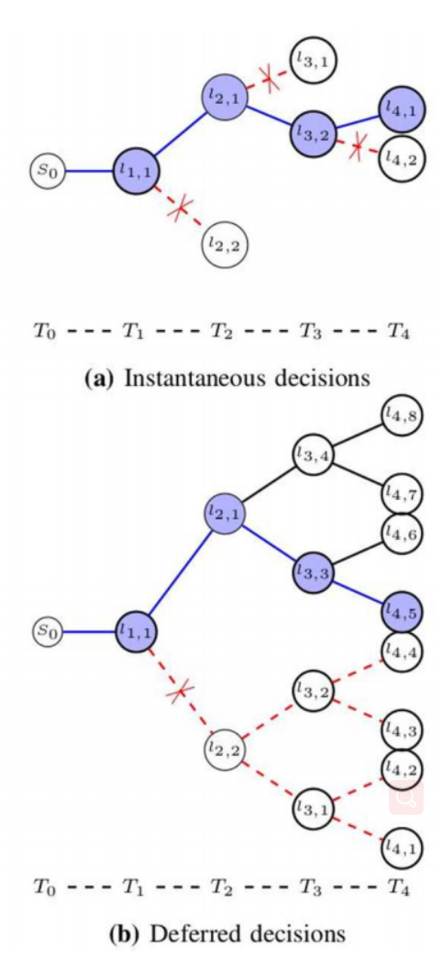
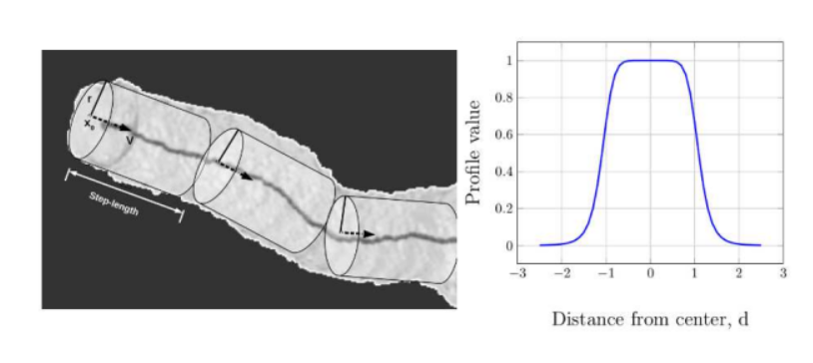
期刊—通过跟踪多个统计排序假设提取CT图像的树状结构
Extracting Tree-structures in CT data by Tracking Multiple Statistically Ranked Hypotheses
Friman et al. Original MHT method.
MHT方法采用预测—更新—聚合的过程来构建假设树。
Predict 预测：
预测步骤是从每个跟踪步骤进行的，其中几个局部假设是在由步长因子控制的规则步长上制定的（用作局部半径的缩放以获得实际步长）。每一步的搜索范围和局部假设的数量分别由搜索角和角度的数量参数来控制。
Update 更新：
更新步骤包括执行与图像数据的模板匹配。模板拟合过程的结果是一个更新的局部假设，并估计了平均强度和对比度值，然后用于量化局部假设的适合度。
Aggregate 聚合：
利用每个步骤的局部假设构造了一个预定搜索深度d的MHT树。
Selvan R , Petersen J , Pedersen J H , et al. Extracting tree structures in CT data by tracking multiple statistically ranked hypotheses[J]. Medical Physics, 2019, 46(10).

Slide 14
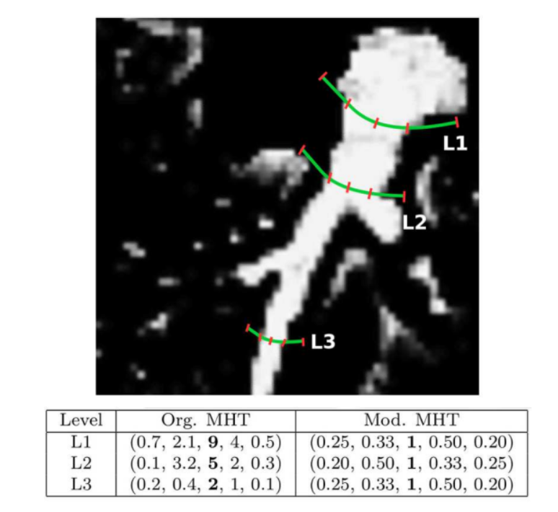
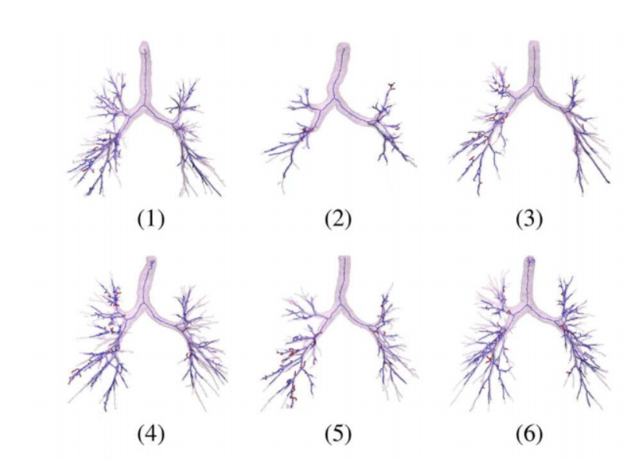
期刊—通过跟踪多个统计排序假设提取CT图像的树状结构
Extracting Tree-structures in CT data by Tracking Multiple Statistically Ranked Hypotheses
Selvan R , Petersen J , Pedersen J H , et al. Extracting tree structures in CT data by tracking multiple statistically ranked hypotheses[J]. Medical Physics, 2019, 46(10).

Slide 15
期刊—Tensor-based的graph-cut实现血管分割，用于肾脏动脉分割
Tensor-cut: A tensor-based graph-cut blood vessel segmentation method and its application to renal artery segmentation
Motivation: 动机
The purpose of this article is to develop a blood vessel segmentation method that can improve segmentation accuracy in tiny blood vessels. In this work, we propose a tensor-based graph-cut method for blood vessel segmentation.
本文的目的是开发一种可以提高小血管分割精度的血管分割方法。在这项工作中，我们提出了一种基于张量的血管分割图切割方法。
Critical method: 关键方法
Each voxel can be modeled by a second-order tensor, allowing the capture of the intensity information and the geometric information for building a more accurate model for blood vessel segmentation.
使用我们的方法，每个体素都可以用一个二阶张量来建模，允许捕获强度信息和几何信息，以建立一个更准确的血管分割模型。
Wang C , Oda M , Hayashi Y , et al. Tensor-cut: A Tensor-based Graph-cut Blood Vessel Segmentation Method and Its Application to Renal Artery Segmentation[J]. Medical Image Analysis, 2019, 60:101623.

Slide 16
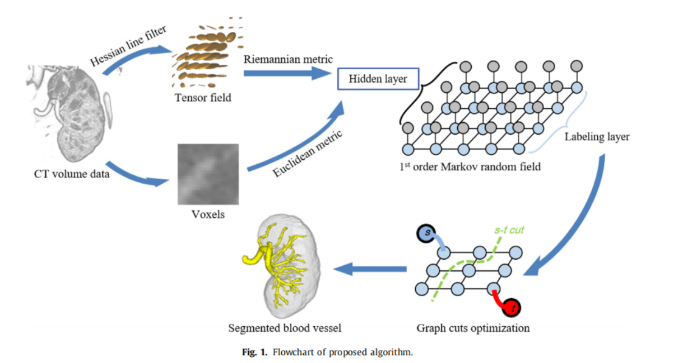
期刊—Tensor-based的graph-cut实现血管分割，用于肾脏动脉分割
Tensor-cut: A tensor-based graph-cut blood vessel segmentation method and its application to renal artery segmentation
Critical method: 关键方法
In this study, we tackle the short-boundary bias issue by introducing tubular geometric information to the MRF model to exploit the advantages of both graph-cut and vesselness-enhancement filtering.
在本研究中，我们将管状几何信息引入MRF模型，以利用图切和血管度增强滤波的优点来解决短边界偏差问题。
Wang C , Oda M , Hayashi Y , et al. Tensor-cut: A Tensor-based Graph-cut Blood Vessel Segmentation Method and Its Application to Renal Artery Segmentation[J]. Medical Image Analysis, 2019, 60:101623.

Slide 17
期刊—采用多目标聚类和环形模型引导的tracking用于全自动的冠脉管腔分割
Automated coronary artery tree segmentation in coronary CTA using a multiobjective clustering and toroidal model-guided tracking method
Motivation: 动机
In clinical medicine, the noise, low contrast, and uneven intensity of medical images along with complex shapes and vessel bifurcation structures make coronary artery segmentation challenging.
在临床医学中，医学图像的噪声、低对比度和不均匀强度以及复杂的形状和血管分叉结构使冠状动脉分割具有挑战性。
Critical method: 关键方法
Utilizing integrated noise reduction, candidate region detection, geometric feature extraction, and coronary artery tracking techniques, a new segmentation framework for 3D coronary artery trees is presented. The candidate regions are extracted using a multiobjective clustering method, and the coronary arteries are tracked by a toroidal model-guided tracking method.
利用综合降噪、候选区域检测、几何特征提取和冠状动脉跟踪技术，提出了一种新的三维冠状动脉树分割框架。采用多目标聚类方法提取候选区域，并采用环状动脉模型引导的跟踪方法对冠状动脉进行跟踪。
Hongwei D U , Shao K , Bao F , et al. Automated coronary artery tree segmentation in coronary CTA using a multiobjective clustering and toroidal model-guided tracking method[J]. Computer Methods and Programs in Biomedicine, 2020, 199(9963):105908.

Slide 18
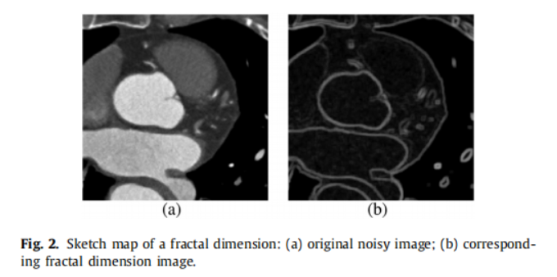
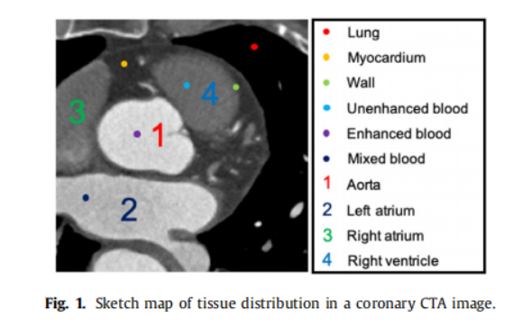
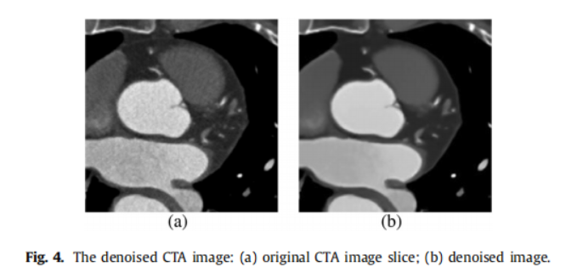
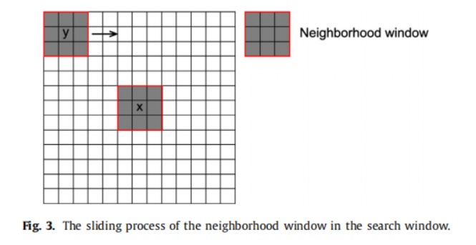
期刊—采用多目标聚类和环形模型引导的tracking用于全自动的冠脉管腔分割
Automated coronary artery tree segmentation in coronary CTA using a multiobjective clustering and toroidal model-guided tracking method
Multiobjective clustering: 多目标聚类
Hongwei D U , Shao K , Bao F , et al. Automated coronary artery tree segmentation in coronary CTA using a multiobjective clustering and toroidal model-guided tracking method[J]. Computer Methods and Programs in Biomedicine, 2020, 199(9963):105908.

Slide 19
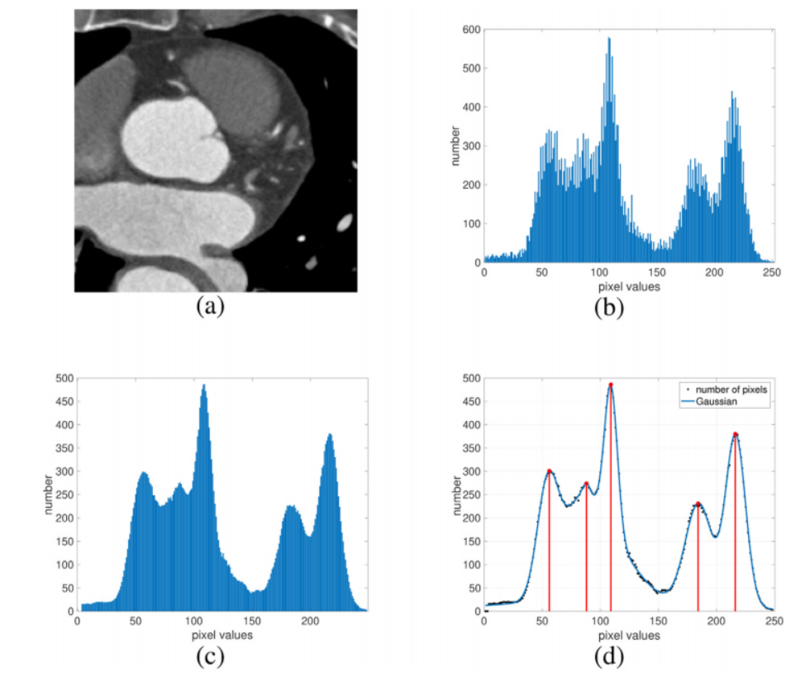
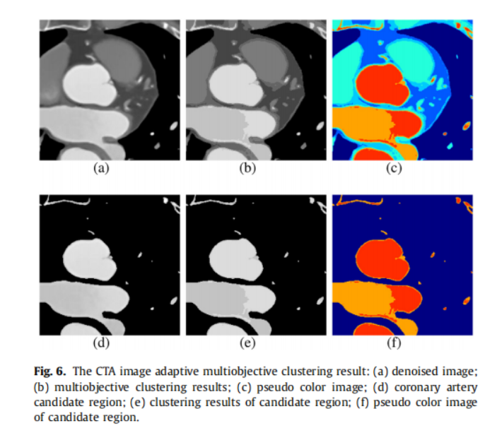
期刊—采用多目标聚类和环形模型引导的tracking用于全自动的冠脉管腔分割
Automated coronary artery tree segmentation in coronary CTA using a multiobjective clustering and toroidal model-guided tracking method
Hongwei D U , Shao K , Bao F , et al. Automated coronary artery tree segmentation in coronary CTA using a multiobjective clustering and toroidal model-guided tracking method[J]. Computer Methods and Programs in Biomedicine, 2020, 199(9963):105908.

Slide 20
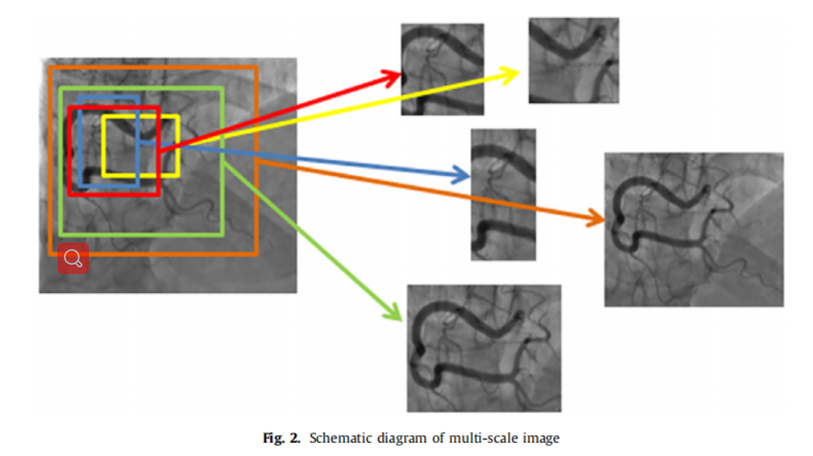
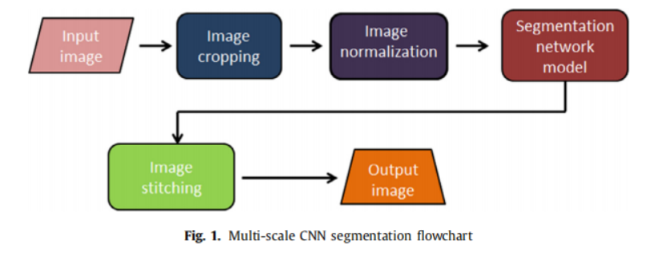
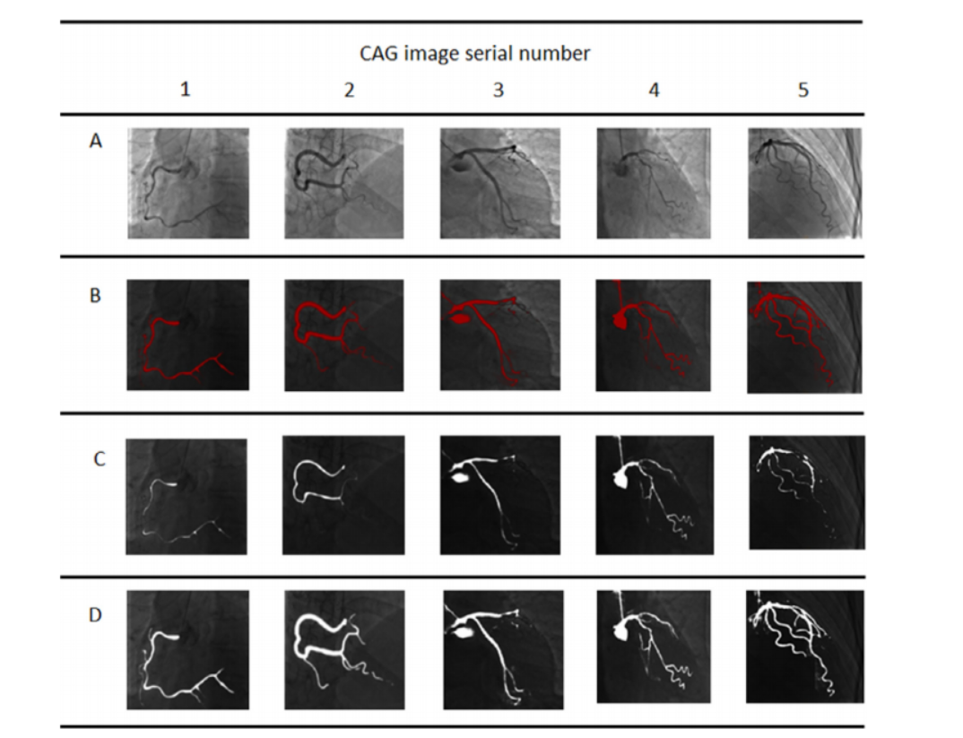
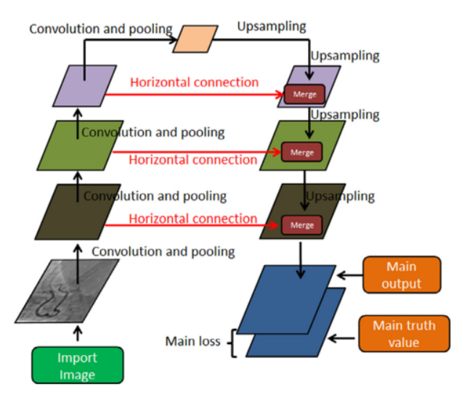
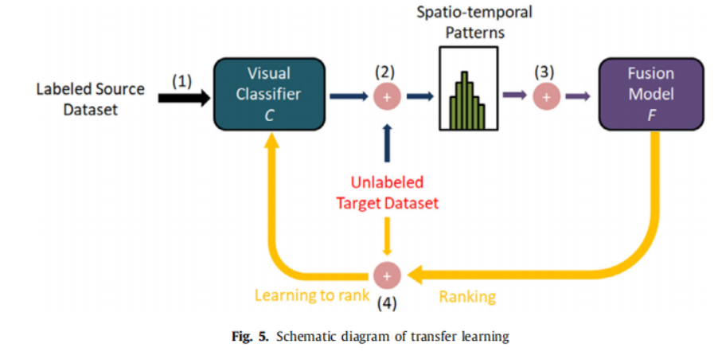
期刊—基于PSPNet实现冠脉造影图像分割
Coronary angiography image segmentation based on PSPNet
Critical method: 关键方法
We implemented the parallel multi-scale convolutional neural network model using PSPNet, using small sample transfer learning that limits parameter learning method.
我们使用PSP网实现了并行的多尺度卷积神经网络模型，使用了小样本迁移学习，限制了参数学习方法。
Zhu X , Cheng Z , Wang S , et al. Coronary angiography image segmentation based on PSPNet[J]. Computer Methods and Programs in Biomedicine, 2020, 200(4):105897.

Slide 21
会议—在视网膜图像上学习的知识迁移到冠状血管分割
Annotation-Free Cardiac Vessel Segmentation via Knowledge Transfer from Retinal Images
Motivation: 动机
Segmenting coronary arteries is challenging, as classic unsupervised methods fail to produce satisfactory results and modern supervised learning (deep learning) requires manual annotation which is often time-consuming and can some time be infeasible.
分割冠状动脉是具有挑战性的，因为经典的无监督方法无法产生令人满意的结果，现代监督学习（深度学习）需要人工注释，这往往是耗时的，而且可能有时是不可实行的。
Critical method: 关键方法
We propose a knowledge transfer based shape-consistent generative adversarial network (SC-GAN), which is an annotation-free approach that uses the knowledge from publicly available annotated fundus dataset to segment coronary arteries. The proposed network is trained in an end-to-end fashion, generating and segmenting synthetic images that maintain the background of coronary angiography and preserve the vascular structures of retinal vessels and coronary arteries.
我们提出了一种基于知识转移的形状一致性生成对抗网络(SC-GAN)，这是一种无注释的方法，利用公开可用的带注释的眼底数据集的知识来分割冠状动脉。该网络以端到端的方式进行训练，生成和分割合成图像，以维持冠状动脉血管造影的背景，并保持视网膜血管和冠状动脉的血管结构。
Yu F , Zhao J , Gong Y , et al. Annotation-Free Cardiac Vessel Segmentation via Knowledge Transfer from Retinal Images[J]. arXiv, 2019.

Slide 22
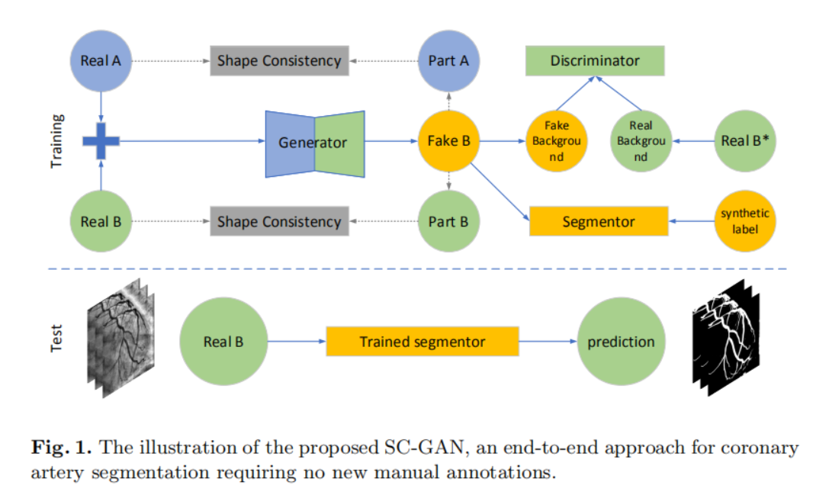
会议—在视网膜图像上学习的知识迁移到冠状血管分割
Annotation-Free Cardiac Vessel Segmentation via Knowledge Transfer from Retinal Images
Yu F , Zhao J , Gong Y , et al. Annotation-Free Cardiac Vessel Segmentation via Knowledge Transfer from Retinal Images[J]. arXiv, 2019.

Slide 23
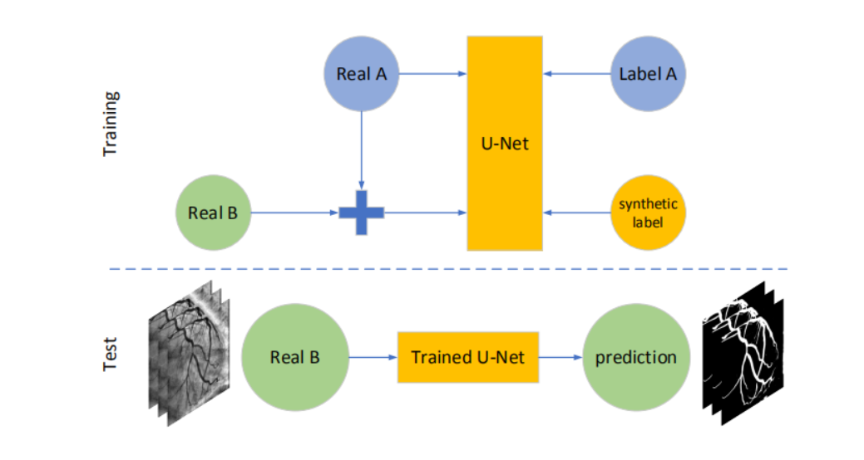
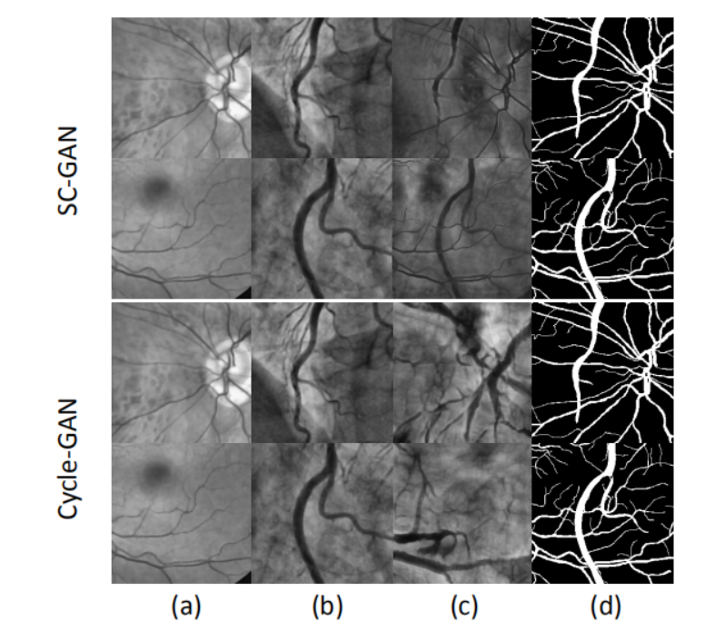
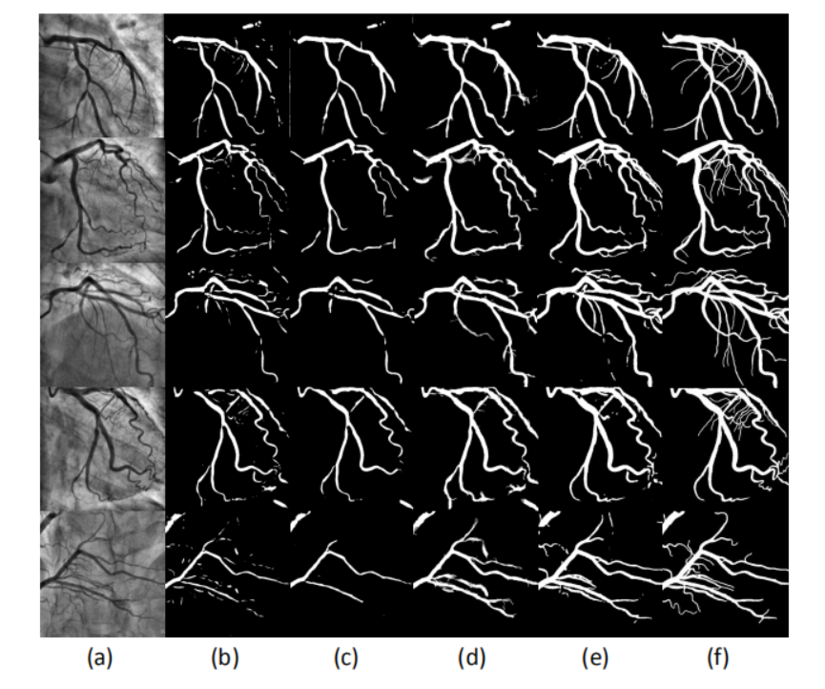
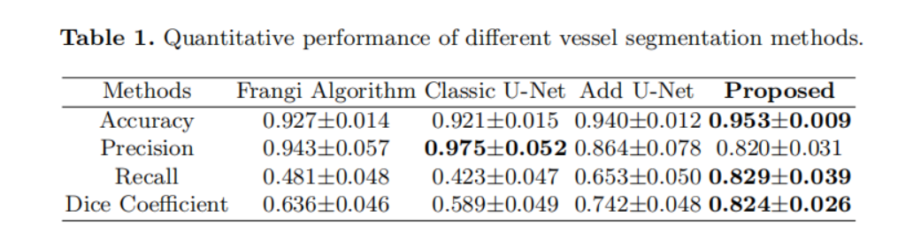
会议—在视网膜图像上学习的知识迁移到冠状血管分割
Annotation-Free Cardiac Vessel Segmentation via Knowledge Transfer from Retinal Images
Yu F , Zhao J , Gong Y , et al. Annotation-Free Cardiac Vessel Segmentation via Knowledge Transfer from Retinal Images[J]. arXiv, 2019.

Slide 24
会议—一个用于中心线提取的多任务全卷积神经网络
DeepCenterline: a Multi-task Fully Convolutional Network for Centerline Extraction
Motivation: 动机
Segmenting coronary arteries is challenging, as classic unsupervised methods fail to produce satisfactory results and modern supervised learning (deep learning) requires manual annotation which is often time-consuming and can some time be infeasible.
分割冠状动脉是具有挑战性的，因为经典的无监督方法无法产生令人满意的结果，现代监督学习（深度学习）需要人工注释，这往往是耗时的，而且可能有时是不可实行的。
Critical method: 关键方法
We propose a knowledge transfer based shape-consistent generative adversarial network (SC-GAN), which is an annotation-free approach that uses the knowledge from publicly available annotated fundus dataset to segment coronary arteries. The proposed network is trained in an end-to-end fashion, generating and segmenting synthetic images that maintain the background of coronary angiography and preserve the vascular structures of retinal vessels and coronary arteries.
我们提出了一种基于知识转移的形状一致性生成对抗网络(SC-GAN)，这是一种无注释的方法，利用公开可用的带注释的眼底数据集的知识来分割冠状动脉。该网络以端到端的方式进行训练，生成和分割合成图像，以维持冠状动脉血管造影的背景，并保持视网膜血管和冠状动脉的血管结构。
Guo Zhihui , Bai Junjie , Lu Yi, et al. DeepCenterline: A Multi-task Fully Convolutional Network for Centerline Extraction[J]. Information Processing in Medical Imaging, 2019.

Slide 25
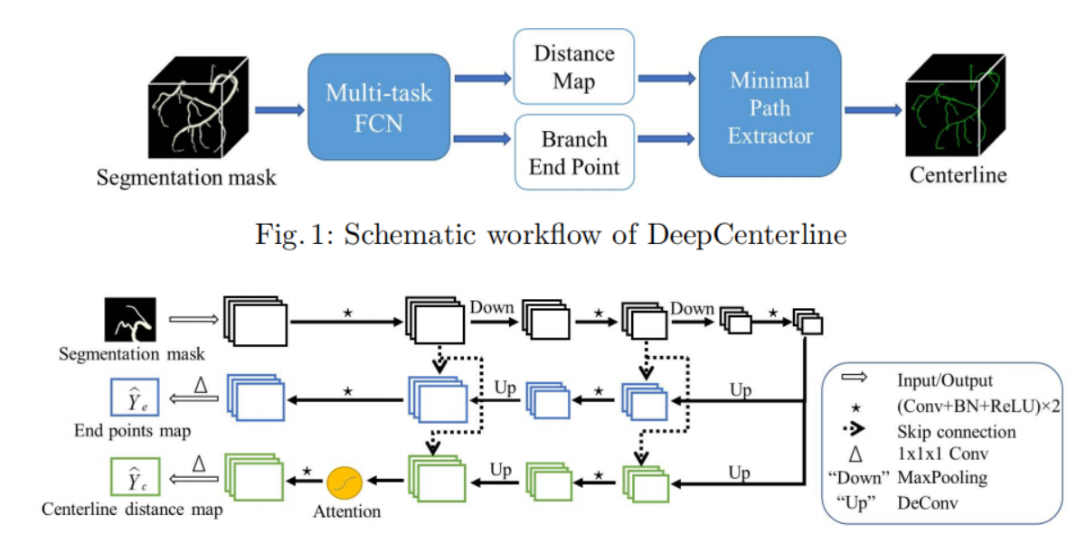
会议—一个用于中心线提取的多任务全卷积神经网络
DeepCenterline: a Multi-task Fully Convolutional Network for Centerline Extraction
Guo Zhihui , Bai Junjie , Lu Yi, et al. DeepCenterline: A Multi-task Fully Convolutional Network for Centerline Extraction[J]. Information Processing in Medical Imaging, 2019.

Slide 26
会议—中心线网络：利用卷积神经网络自动提取冠脉中心线
CenterlineNet: Automatic Coronary Artery Centerline Extraction for Computed Tomographic Angiographic Images Using Convolutional Neural Network Architectures
Motivation: 动机
The prevention of cardiovascular diseases starts by a thorough examination of the coronary artery vessels for atherosclerotic plaques existence.
心血管疾病的预防首先是彻底检查冠状动脉血管是否存在动脉粥样硬化斑块。
Critical method: 关键方法
The proposed method is based on a 3D convolutional neural network used as a local vessel centerline detector to extract the main and side branches of the coronary artery tree. Coupled with a preprocessing vessel enhancing step, the model takes advantage of the analytical analysis of the former as well as the feature extraction ability of the CNN. In addition, automatic aorta and heart region detections are also performed to delineate the origin and the extent of the coronary tree and phase out the false predictions.
该方法基于三维卷积神经网络作为局部血管中心线检测器，提取冠状动脉树的主支和侧支。结合预处理容器增强步骤，该模型利用了前者的分析以及CNN的特征提取能力。此外，还进行自动主动脉和心脏区域检测，以描述冠状动脉树的起源和范围，并逐步消除错误的预测。
Guanyu, Yang, Pieter, et al. Automatic centerline extraction of coronary arteries in coronary computed tomographic angiography[J]. International Journal of Cardiovascular Imaging, 2011.

Slide 27
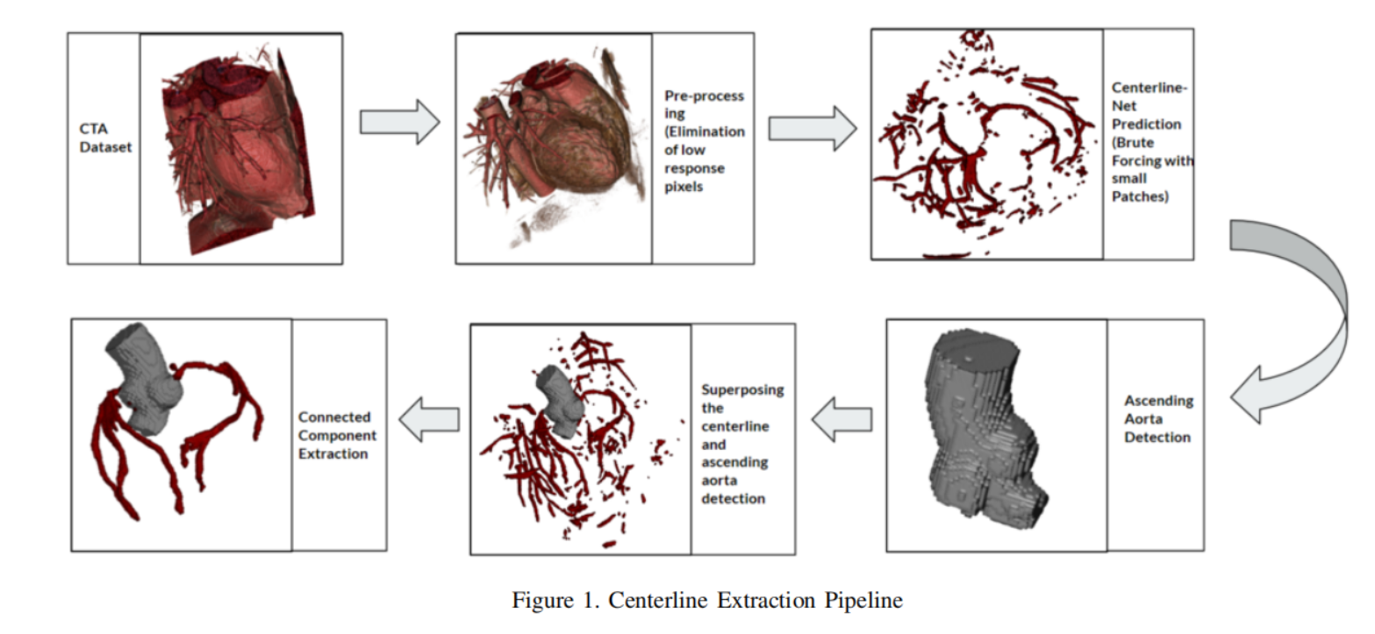
会议—中心线网络：利用卷积神经网络自动提取冠脉中心线
CenterlineNet: Automatic Coronary Artery Centerline Extraction for Computed Tomographic Angiographic Images Using Convolutional Neural Network Architectures
依靠蛮力获得小块
叠加
升主动脉检测
连续提取
Guanyu, Yang, Pieter, et al. Automatic centerline extraction of coronary arteries in coronary computed tomographic angiography[J]. International Journal of Cardiovascular Imaging, 2011.

Slide 28
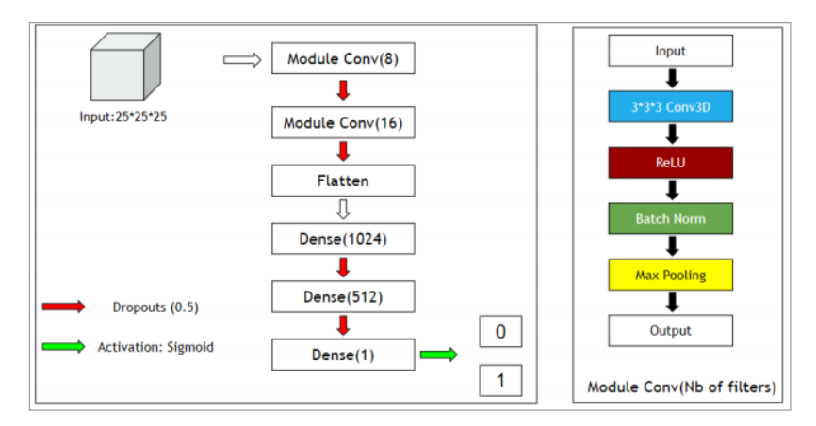
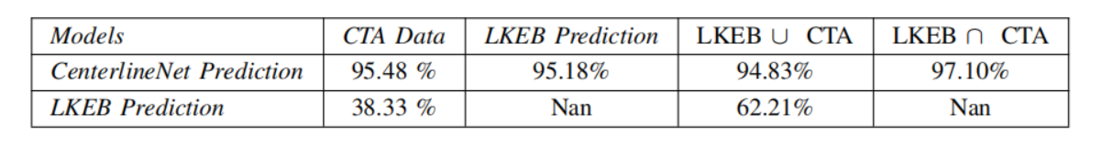
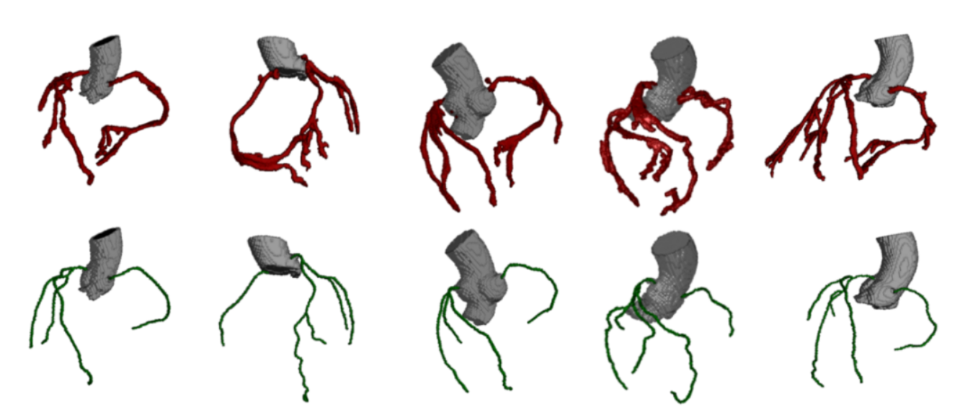
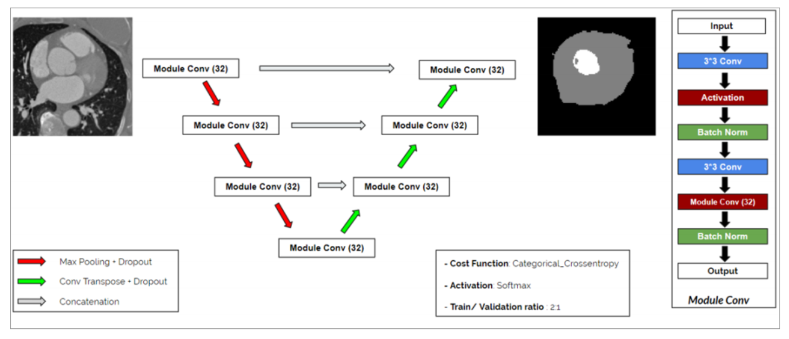
会议—中心线网络：利用卷积神经网络自动提取冠脉中心线
CenterlineNet: Automatic Coronary Artery Centerline Extraction for Computed Tomographic Angiographic Images Using Convolutional Neural Network Architectures
Guanyu, Yang, Pieter, et al. Automatic centerline extraction of coronary arteries in coronary computed tomographic angiography[J]. International Journal of Cardiovascular Imaging, 2011.

Slide 29
综述—将领域知识融入深度学习用于医学图像分析
A survey on incorporating domain knowledge into deep learning for medical image analysis
Motivation: 动机
Although deep learning models like CNNs have achieved great success in medical image analysis, the small size of medical datasets remains a major bottleneck in this area. To address this problem, researchers have started looking for external information beyond current available medical datasets.
虽然像CNN这样的深度学习模型在医学图像分析方面取得了巨大的成功，但医学数据集数量小仍然是这一领域的主要瓶颈。为了解决这个问题，研究人员已经开始寻找现有医学数据集之外的外部信息。
This work: 本文总结
More recent works utilize the domain knowledge from medical doctors, to create networks that resemble how medical doctors are trained, mimic their diagnostic patterns, or focus on the features or areas they pay particular attention to. In this survey, we summarize the current progress on integrating medical domain knowledge into deep learning models for various tasks, such as disease diagnosis, lesion, organ and abnormality detection, lesion and organ segmentation.
近期的工作利用来自医生的领域知识，建立类似于医生如何被训练、模仿他们的诊断模式或专注于他们特别关注的特征或领域的网络。 在这项综述中，我们总结了目前在将医学领域知识集成到各种任务的深度学习模型中的进展，如疾病诊断、病变、器官和异常检测、病变和器官分割。
Xie X , Niu J , Liu X , et al. A Survey on Incorporating Domain Knowledge into Deep Learning for Medical Image Analysis[J]. 2020.

Slide 30
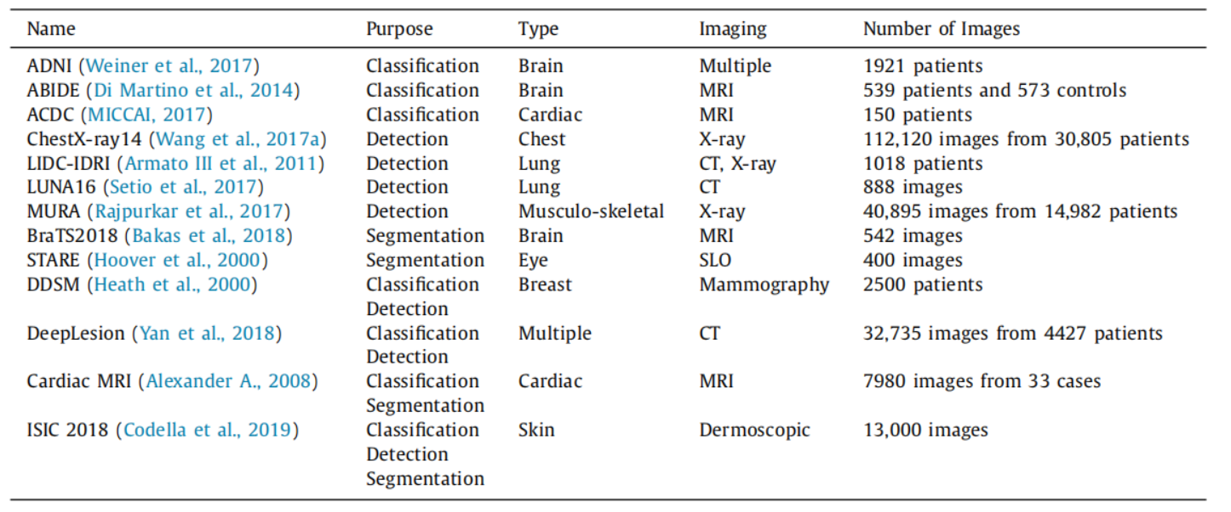
综述—将领域知识融入深度学习用于医学图像分析
A survey on incorporating domain knowledge into deep learning for medical image analysis
Xie X , Niu J , Liu X , et al. A Survey on Incorporating Domain Knowledge into Deep Learning for Medical Image Analysis[J]. 2020.

Slide 31
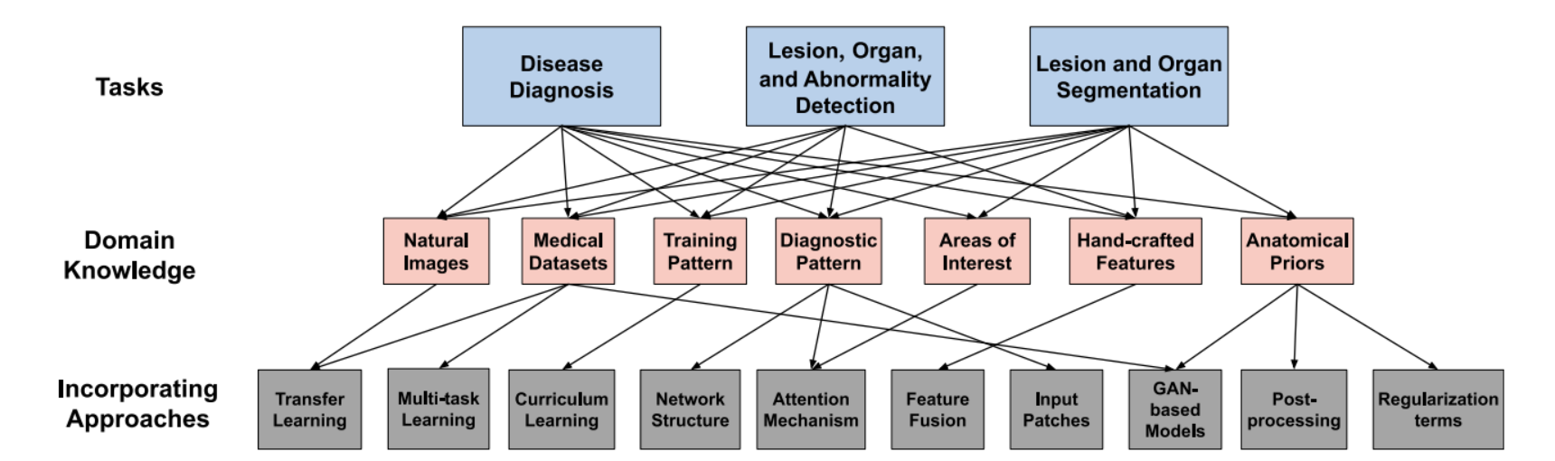
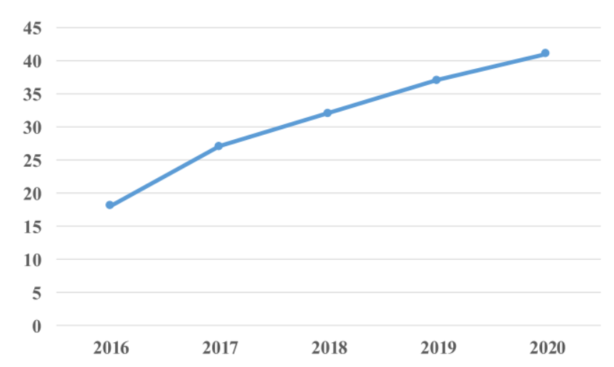
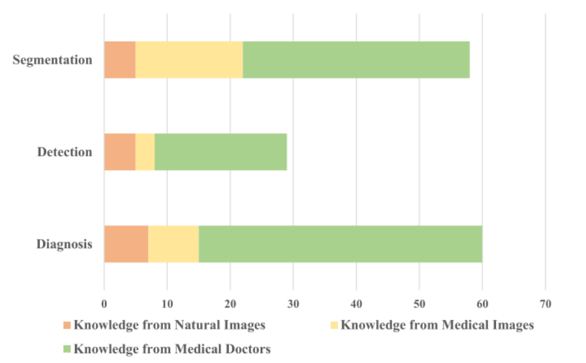
综述—将领域知识融入深度学习用于医学图像分析
A survey on incorporating domain knowledge into deep learning for medical image analysis
Xie X , Niu J , Liu X , et al. A Survey on Incorporating Domain Knowledge into Deep Learning for Medical Image Analysis[J]. 2020.

Slide 32
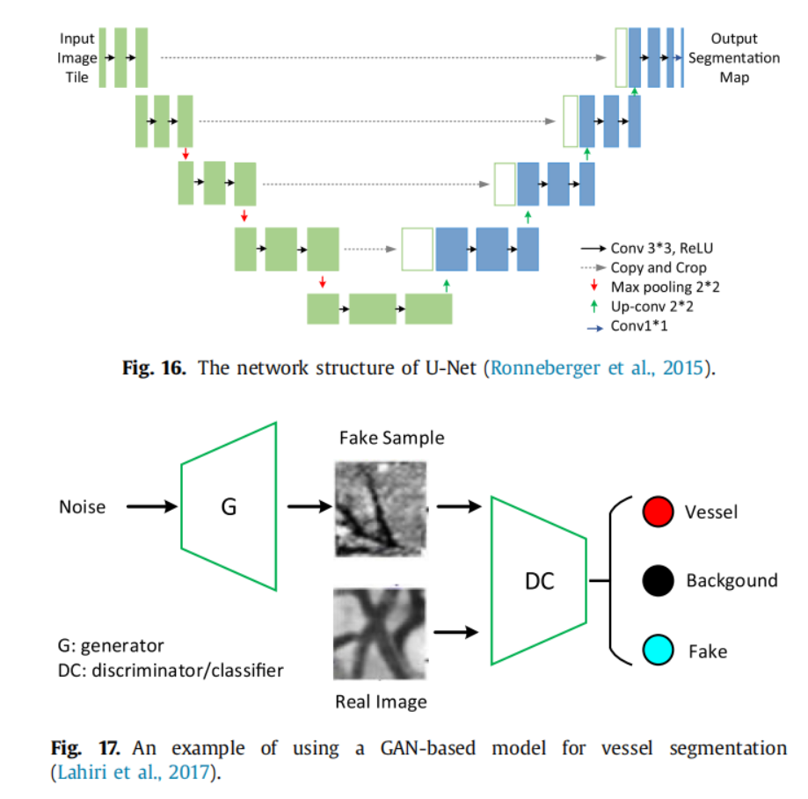
综述—将领域知识融入深度学习用于医学图像分析
A survey on incorporating domain knowledge into deep learning for medical image analysis
Method: 来自自然图像和其它医学数据集
1. 深度学习分割模型首先在一个大规模的自然图像数据集（如图像网）上进行训练，然后对目标数据集进行微调，这也是很常见的。利用上述迁移学习策略从自然图像中引入知识，证明了在医学图像分割中具有更好的性能。
2. 除了使用在“静态”数据集上预先训练的模型，如ImageNet和PASCALVOC，许多深层神经网络，特别是那些设计用于分割三维内侧图像的网络，利用在大规模视频数据集上预先训练的模型。
3. 除了自然图像外，使用来自不同模态和不同疾病的外部医学数据集的知识也是相当受欢迎的。
4. 此外，许多工作采用基于GAN的模型来实现不同模式的数据集之间的域转换。
5. 还有一些工作利用其他疾病的数据集
Xie X , Niu J , Liu X , et al. A Survey on Incorporating Domain Knowledge into Deep Learning for Medical Image Analysis[J]. 2020.

Slide 33
综述—将领域知识融入深度学习用于医学图像分析
A survey on incorporating domain knowledge into deep learning for medical image analysis
Method: 融合来自医生的知识
在深度分割模型中使用的医学医生的领域知识类型可分为四类：1.训练模式；
2.他们查看图像的一般诊断模式；
3.病变或器官的解剖先验（例如形状、位置、拓扑结构）；
4.他们特别注意的其他手工制作的特征。
与非医学图像相比，医学图像具有许多解剖学上的先验，如器官或病变的形状、位置和拓扑结构。经验丰富的医生在对这些图像进行分割任务时，非常依赖于这些解剖学上的先验。
1. 在后处理阶段合并了解剖学先验
2. 将解剖学先验作为损失函数中的正则化项
3. 通过生成模型学习解剖学先验。
Xie X , Niu J , Liu X , et al. A Survey on Incorporating Domain Knowledge into Deep Learning for Medical Image Analysis[J]. 2020.

